Slide 1

What is Engineering? How does it affect the lives of everyone? & What is the design process?
Presented By: Dan Borchardt P.E. M.ASCE – Civil Engineer

Slide 2





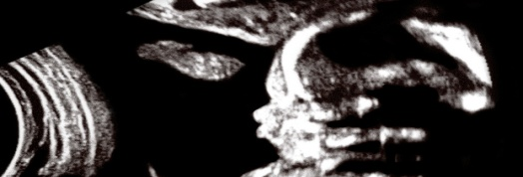


Which of these pictures
involve engineering?
Providing water
Solving
problems
Make-up & fashion
Creating cars
Health and medicine
Gadgets galore
Food
Sports

Slide 3




Engineering is everywhere…
Almost everything you eat, wear, use and like to do involves engineering.
From everyday things like your mobile, computer and clothes to medicine, space, national security and renewable energy.
… to tackling climate change, providing clean drinking water or ensuring sustainable food supplies.

Slide 4
What is engineering?
According to Webster’s Dictionary:
Engineering
The application of math and science by which the properties
of matter and the sources of energy in nature are made useful
to people.
Engineers apply math and science for the betterment of society through:
Design
Manufacturing
Research & Development
Management
Continual Improvement
Logistics
Above all, engineers are problem solvers who make things work better, more efficiently, quicker and cheaper.

Slide 5
Engineering Disciplines
Major Disciplines
Other Disciplines
Mechanical
Electrical
Chemical
Industrial
Civil
Automotive
Aerospace
Agricultural
Biomedical
  Computer
  Materials
  Nuclear
  Robotics
  Safety

Slide 6
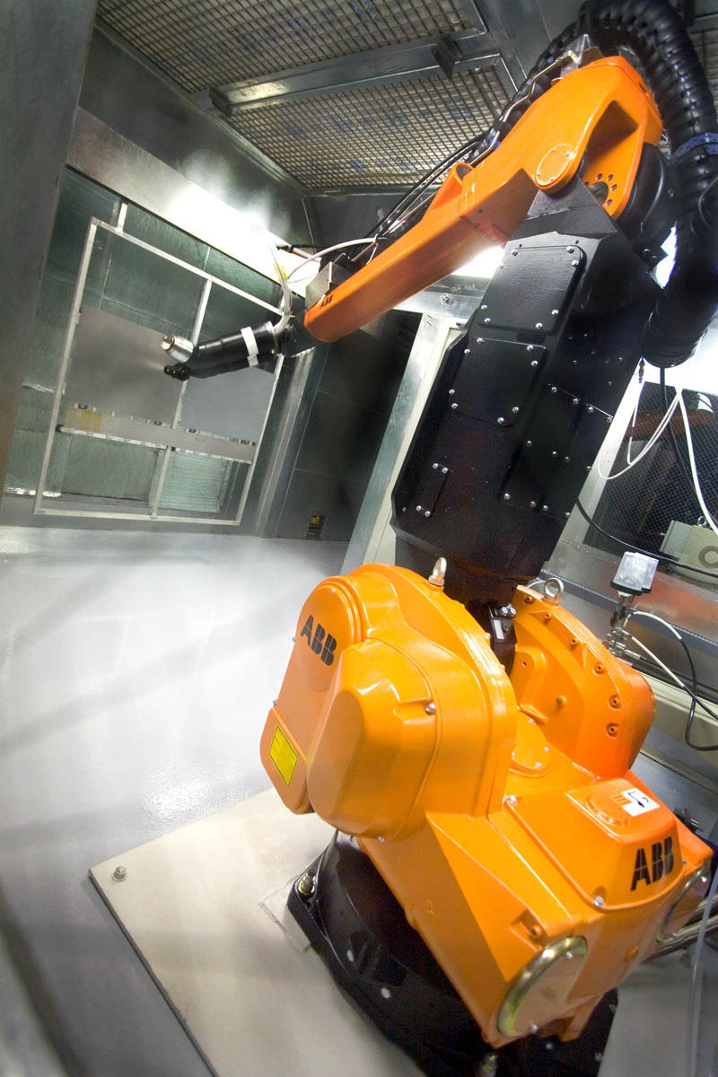
Mechanical Engineering
Concerned with design, manufacture & operation of a wide range of components, devices, or systems:
  microscopic parts (nanotechnology) to gigantic gears
  heating, ventilation, refrigeration
  manufacturing equipment (tanks, motors, pumps)
  laser technology
  biomedical applications
  automotive industry
  computer-aided design, automation, robotics
Broadest of all the engineering disciplines in its range of activities

Slide 7

Chemical Engineering
  Gasoline
  Plastic
  Energy (natural gas, oil heating, coal)
  Adhesives
  Clothing
  Building Materials
Applying chemistry to the solution of practical problems

Slide 8
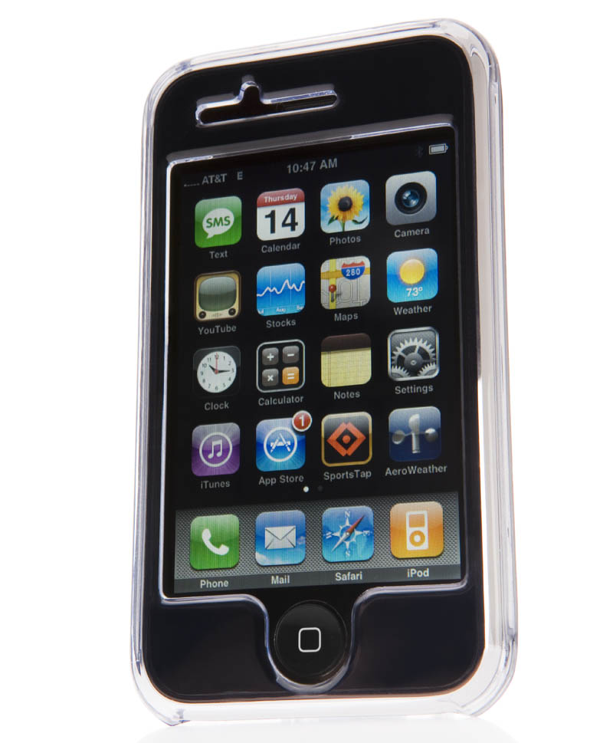
Electrical Engineering
Play a role in almost everything we
interact with on a daily basis. They
design smaller, cheaper, and better:
  cell phones
  computers
  power systems
  appliances
  robots
Apply specialized skill to the design, manufacture, application, installation, and operation of electrical products and systems.

Slide 9

Industrial Engineering
  Design data processing systems
  Integrate activities of finance, engineering and management
  Develop systems for planning, cost analysis, production and
quality of products
Stresses design, improvement, and installation of integrated systems of people, material, and equipment for the effective production of goods or services in all types of industries

Slide 10

Civil Engineering
Civil Engineering can be further broken into sub-disciplines
  Structural Engineering
  Transportation Engineering
  Construction Engineering
  Geotechnical Engineering
  Urban Planning
  Water Resource Engineering
Environmental Engineering
Building and Landscape Architecture
Surveying
Design solutions to cope with many of our planet’s most serious problems.

Slide 11
Structural Engineering
Analyze and design structures to make sure they are safe
Materials: steel, concrete, aluminum, timber, plastic and exotic materials
Structures must be able to:
  Support loads
  Withstand hurricanes, earthquakes, blizzards, and floods
Notes:
<No mouse clicks required on this slide.>
As a structural engineer, you will face the challenge of analyzing and designing structures to ensure that they safely perform their purpose. They must support their own weight and resist dynamic environmental loads such as hurricanes, earthquakes, blizzards, and floods.

Slide 12
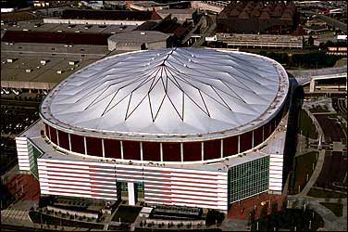
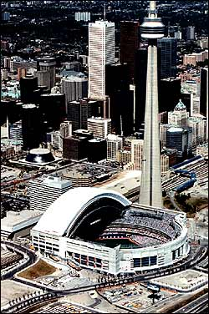
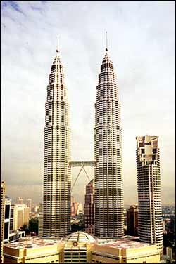
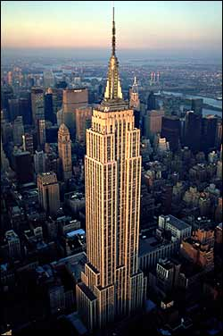
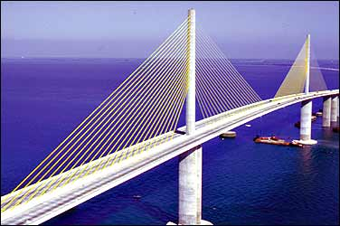
Structural Engineering
Examples:
  Stadiums and arenas
  Skyscrapers
  Offshore oil structures
  Space platforms
  Amusement park rides
  Bridges
  Office buildings
Notes:
<This slide requires mouse clicks to list the examples and to show the pictures. Ask students to name TYPES of structures (not necessarily SPECIFIC structures). Then quiz them on each of the photos.>
Stadiums, arenas, skyscrapers, offshore oil structures, space platforms, amusement park rides, bridges, office buildings, and homes are a few of the many types of projects in which structural engineers are involved.
Photos:
Georgia Dome (Atlanta, GA)
Skydome and CN Tower (Toronto, Canada)
Empire State Building
Petronas Towers (Malaysia)
Sunshine Skyway Bridge (Tampa, FL)

Slide 13


Transportation Engineering
Move people, goods, and materials safely and efficiently
Find ways to meet the increasing travel needs on land, air and sea
Notes:
<No mouse clicks required on this slide.>
Because the quality of a community is directly related to the quality of its transportation system, your function as a transportation engineer will be to move people, goods, and materials safely and efficiently. Your challenge will be to find ways to meet the increasing travel needs on land, air and sea.

Slide 14
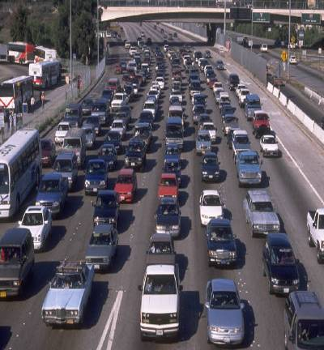

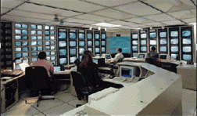
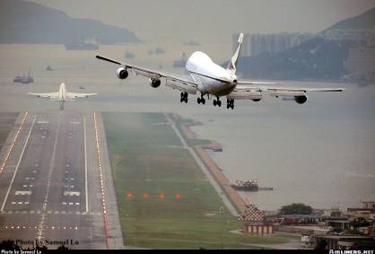
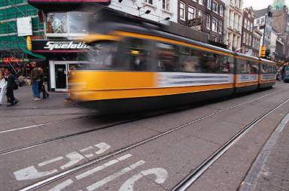
Transportation Engineering
Design, construct, and maintain:
  Highways
  Railroads
  Airfields
  Ports
Improve traffic control and mass transit systems
Introduce other new transportation methods
Photo used w/ permission
www.airliners.net
Notes:
<This slide requires mouse clicks to build the text and then show each pictures. Ask students to name TYPES of transportation modes before revealing.>
You will design, construct, and maintain all types of facilities, including highways, railroads, airfields, and ports. An important part of transportation engineering is to upgrade our transportation capability by improving traffic control and mass transit systems, and by introducing high-speed trains, people movers, and other new transportation methods.
2nd photo is a traffic management center (sometimes called a freeway operations center).
Aircraft photo is of 2 Boeing 747’s taking off and landing at Hong Kong Int’l Airport

Slide 15
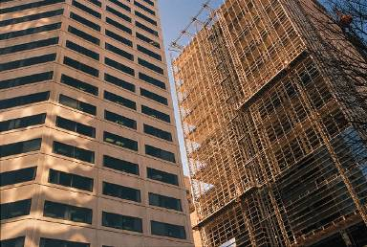
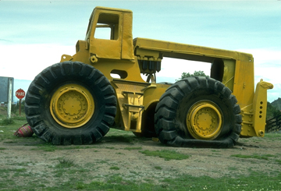

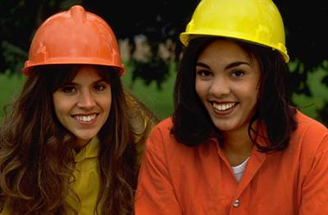
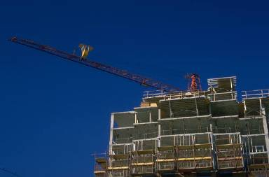
Construction Engineering
Builder of our future
Turn designs into reality -- on time and within budget
Knowledge of:
  Construction methods and equipment
  Principles of financing, planning, and managing
Notes:
<Mouse clicks reveal photos.>
As a construction engineer, you will be a builder of our future. The construction phase of a project represents the first tangible result of a design. Using your technical and management skills, you will help turn designs into reality -- on time and within budget. You will apply your knowledge of construction methods and equipment, along with principles of financing, planning, and managing, to turn the designs of other engineers into successful facilities.

Slide 16
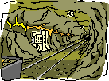
Geotechnical Engineering
Almost every project is in, on, or made with earth materials
In the earth:
  Tunnels
  Deep foundations
  Pipelines
On the earth:
  Highway pavements
  Buildings
Notes:
<No mouse clicks required on this slide.>
Almost all of the facilities that make up our infrastructure are in, on, or with earth materials, and geotechnical engineering is the discipline that deals with applications of technology to solve these problems. Examples of facilities in the earth are tunnels, deep foundations, and pipelines. Highway pavements and many buildings are supported on the earth.

Slide 17
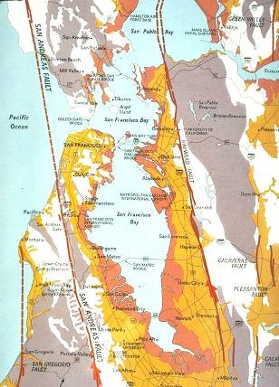
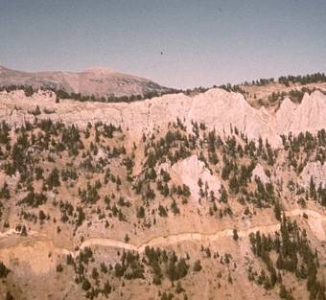

Geotechnical Engineering
Made of earth:
  Earth dams
  Levees
  Embankments
  Slopes
Analyses based on mechanics and mathematics
Understanding earthquakes
Notes:
<Mouse clicks reveal photos.>
And earth dams, levees, embankments, and slopes are constructed with the earth. In addition, many soil-like waste materials are deposited in containment areas. To design these facilities, geotechnical engineers must conduct analyses based on the principles of mechanics and mathematics. These analyses require input data to quantify the properties of the earth materials, and this information is usually obtained from laboratory or field tests.
3rd image is a map of the fault lines in the San Francisco area
4th image is a photo of an actual fault line (see the squiggly light colored line near the bottom of the photo).

Slide 18

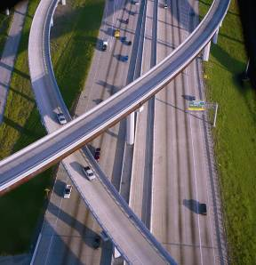


Urban Planning
Full development of a community
Integrate freeways, airports, and other related facilities
Projects may include:
  Projecting street patterns
  Identifying park and recreation areas
  Determining areas for industrial and residential growth
Notes:
<Mouse clicks reveal photos.>
As a professional in this area, you will be concerned with the full development of a community. Analyzing a variety of information will help you coordinate projects, such as projecting street patterns, identifying park and recreation areas, and determining areas for industrial and residential growth.

Slide 19



Water Resource Engineering
Issues concerning the quality and quantity of water
You might work to
  Prevent floods
  Supply water for cities, industry and irrigation
  Treat wastewater
  Protect beaches
  Manage and redirect rivers
Notes:
<No mouse clicks required on this slide.>
Water is essential to our lives, and as a water resources engineer, you will deal with issues concerning the quality and quantity of water. You will work to prevent floods, to supply water for cities, industry and irrigation, to treat wastewater, to protect beaches, or to manage and redirect rivers.

Slide 20
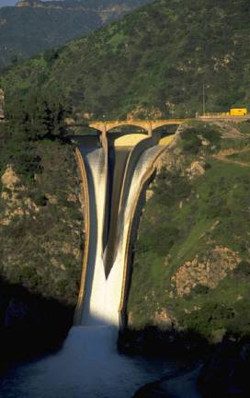

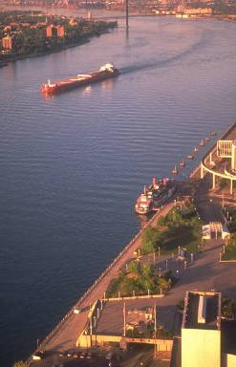
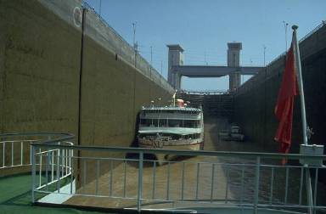
Water Resource Engineering
Design, construction, or maintenance of:
  Hydroelectric power facilities
  Canals
  Dams
  Pipelines
  Pumping stations
  Locks
  Seaport facilities
Notes:
<Mouse clicks reveal photos.>
You might be involved in the design, construction, or maintenance of hydroelectric power facilities, canals, dams, pipelines, pumping stations, locks, or seaport facilities.

Slide 21
Environmental Engineering
Environmental engineering is the application of scientific and engineering principles to:
  Improve and maintain the environment for the protection of human health.
  For the protection of nature's beneficial ecosystems and biodiversity and for environment-related enhancement of the quality of human life.

Slide 22
Environmental Engineering
Environmental engineers conduct studies on streams, lakes, air, soil and groundwater to determine the extent and severity of contamination.
Design systems to:
  Destroy toxic substances
  Remove pollutants from water
  Reduce non-hazardous solid waste volumes
  Eliminate contaminants from the air
  Develop groundwater supplies
Notes:
<No mouse clicks required on this slide.>
The skills of environmental engineers are becoming increasingly important as we attempt to protect the fragile resources of our planet. Environmental engineers translate physical, chemical, and biological processes into systems to destroy toxic substances, remove pollutants from water, reduce non-hazardous solid waste volumes, eliminate contaminants from the air, and develop groundwater supplies.

Slide 23

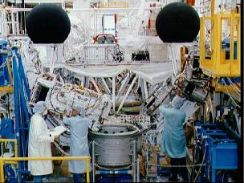
Environmental Engineering
Resolve problems of:
  Providing safe drinking water
  Cleaning up sites contaminated with hazardous materials
  Cleaning up and preventing air pollution
  Treating wastewater
  Managing solid wastes
Notes:
<No mouse clicks required on this slide.>
In this field, you might be called upon to resolve problems of providing safe drinking water, cleaning up sites contaminated with hazardous materials, cleaning up and preventing air pollution, treating wastewater, and managing solid wastes.

Slide 24
What is Architecture?
Architects create the overall aesthetic and look of buildings and other structures, but the design of a building involves far more than its appearance.
Architects spend a great deal of time explaining their ideas to clients, construction contractors, and others. Successful architects must be able to communicate their unique vision persuasively.
Architects work with engineers, urban planners, interior designers, landscape architects, and other professionals.

Slide 25
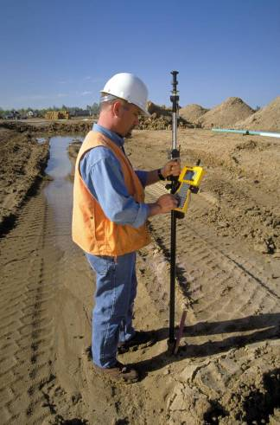
What is Surveying?
The measurement of dimensional relationships among points, lines, and physical features, on or near the Earth's surface.
Basically, surveying determines horizontal distances, elevation differences, directions, and angles to specific features for mapping and design purposes.

Slide 26
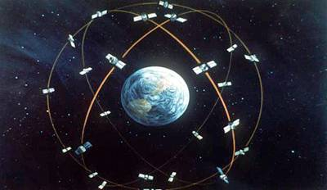
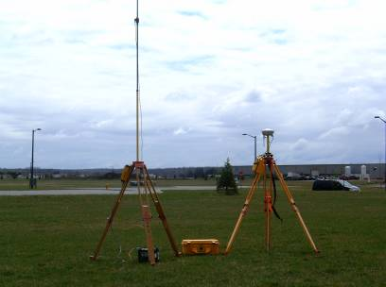
How Does Surveying Work?
Surveying is typically used to locate and measure property lines; to lay out buildings, bridges, channels, highways, sewers, and pipelines for construction, and to obtain topographic information for mapping and charting.

Slide 27
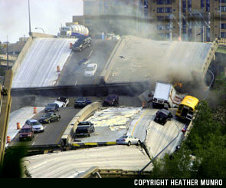
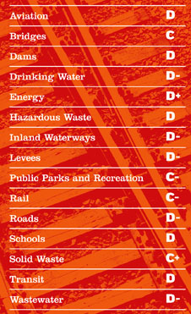
Why do we need Engineers?
Sometimes bad things can happen
We must learn from them
Our infrastructure report card (2009)
Notes:
<Click on the image to start the short film.>
Quick facts about the Tacoma Narrows Bridge collapse:
Collapsed on Nov. 7, 1940
Nicknamed “Galloping Gertie” by locals
Aerodynamic forces caused the deck to move up and down (it acted like an airplane wing)
The undulations were an attraction (sometimes 3-5 feet)
The bridge was closed about an hour before the collapse (no one died during the collapse)
Engineers at the time did not understand all of the forces that acted on the bridge.
This slide may likely bring up questions about the WTC disaster. It is important to note that the exact cause of what caused the buildings to fail has not been determined yet. Many experts, including civil engineers, are attempting to determine that now. While not official, the commonly held theory is that the crash of the jets themselves did not cause the towers to collapse. Rather, the intense heat from burning jet fuel caused a weakening in the upper structure. This weakening then caused the top floors to collapse onto the lower floors, thereby causing the entire structure to fall. It has been noted in various sources that the towers were designed to withstand the impact of a Boeing 707 (the largest commercial jetliner at the time). Just as with the Tacoma Narrows bridge collapse, engineers will learn from this disaster and likely make changes to future building designs.

Slide 28



Create, develop, produce…
Engineering’s about…
Finding out what people need, developing an idea and seeing how it can be made at a good price.
Developing the ‘product’ on time and running tests to make sure it’s safe and reliable. Developing is a decision making process in which the basic sciences and mathematics and engineering sciences are applied to convert resources optimally to meet our objectives.
Producing something that makes our lives better… whether that’s a new games console, high-tech sports equipment or quicker, greener and safer travel.

Slide 29
The Design Process
Identify the problem
Brainstorm ideas
Design
Build
Test and Evaluate
Redesign
Share Solution

Slide 30
Where do Civil Engineers,
Architects and Surveyors Work?
Government
  Federal, state, county, city organizations
Consulting
  Firms of all sizes (you can even start your own)
Research
  Universities and other private corporations
Notes:
<No mouse clicks required on this slide.>

Slide 31
Advisable College Prep Classes
Math
  Algebra
  Trigonometry
  Geometry
  Calculus
  Statistical Analysis
Physics
Chemistry
Geology
Speech
Technical Writing

Slide 32
Skills Employers Seek
Successfully apply technical knowledge to solve mathematical, practical and engineering problems.
Effectively and accurately communicate technical information orally and in writing.
Rational Judgment
Ethical
People-oriented
Teamwork

Slide 33
What You Need To become a
Civil Engineer
Bachelor’s degree in civil engineering
  More than 200 accredited university programs
Consider additional training
  Master’s degree in specialty area
Obtain a professional engineer’s license
  Typically requires 4 years of experience and passing two examinations
Notes:
<No mouse clicks required on this slide.>

Slide 34
What You Need To become an
Architect
Bachelor’s degree in architecture
  One of than 114 accredited university programs
Consider additional training
  Master’s degree in specialty area
Obtain a professional architects license
  Usually at least 3 years experience—before they may sit for the licensing exam.
Notes:
<No mouse clicks required on this slide.>

Slide 35

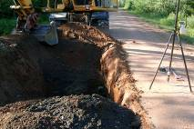
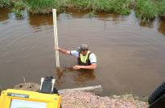
What You Need To become an
Registered Land Surveyor
4 year Bachelor’s degree in surveying
  One year experience
2 year Associate’s degree in surveying
  Three years experience
9 years experience
Obtain a Registered Land Surveyors license
  3 exams required for licensing

Slide 36
Average Starting Salaries
Civil Engineer
  $47,000
Environmental Engineer
  $45,000
Land Surveyor
  $35,000
Architect
  $33,000

Slide 37

Good Traits for Engineers
Enjoy solving problems
Like working with other people (strong teamwork skills)
Interested in serving human needs
Want to make things work better
Strive for continual improvement
Able to adapt to a changing environment
Good communication skills
Strong study skills
Desire to constantly learn new things
Data analysis skills
Strong computer skills

Slide 38



Why I recommend engineering…
Being part of a creative process.
Designing solutions to meet customers’ needs.
Continually testing and improving technology.
The range of roles and responsibilities.
Working in a team.
Do something different every day.
Excellent salaries are achievable.

Slide 39
Summary
Engineers have been involved in almost everything you see,
touch, or rely upon
Engineering can be an exciting career full of opportunities
Opportunities for leadership, global travel, and benefiting humankind abound
An engineering degree can open many doors to careers in other exciting areas such as medicine, law, business administration, PhD (research, teaching, etc.)

Slide 40
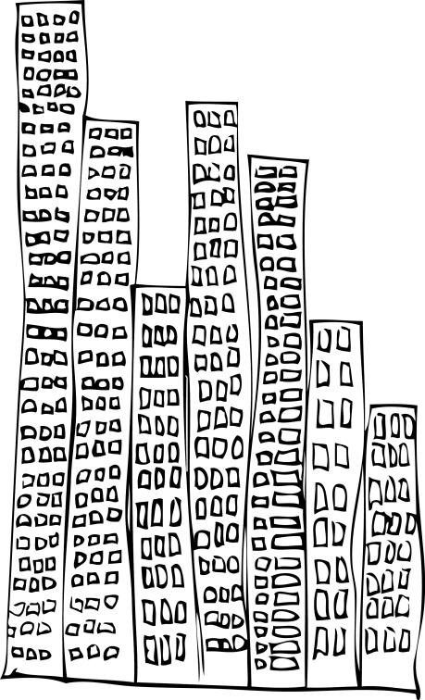



Now - ask me more…

